Slide 1
Native Advertising

Slide 2
Native Advertising
“Any paid advertising that takes the specific form and appearance of editorial content from the publisher itself “
-Wojdynski & Evens, 2016

Slide 3
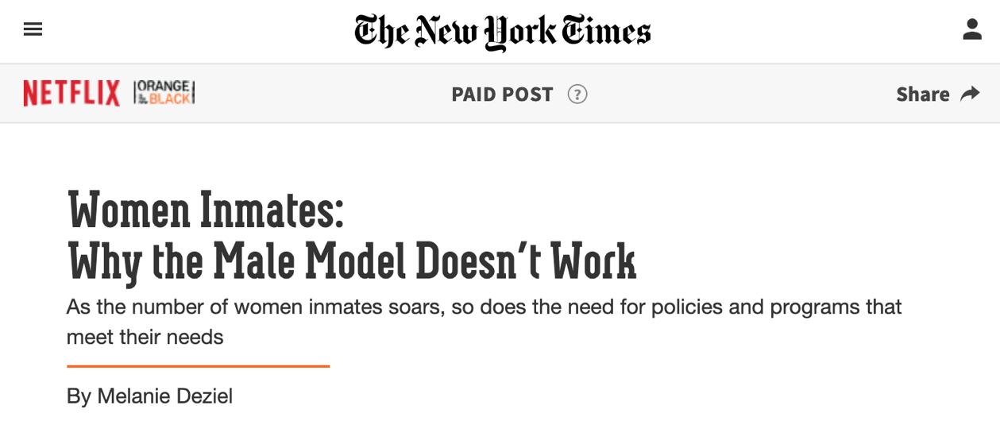
Sponsored Content
“A hybrid between advertising and journalism.”
-Ikonen, Luoma-aho, and Bowen (2016)
“It is about creating content that is so appealing that the potential customer wants to enjoy it, unlike advertising which is generally just disliked and skipped”
-Lehto, Moisala (2018)

Slide 4
Disclosure
Two main Factors
Identification
Comprehension
Disclosure Language
Sponsored Content
#ad
Paid Content

Slide 5
Disclosure
Federal Trade Commission mandates disclosure must be:
In clear and unambiguous language
As close as possible to the native ads to which they relate
In a font and color that is easy to read
In a shade that stands out against the background

Slide 6
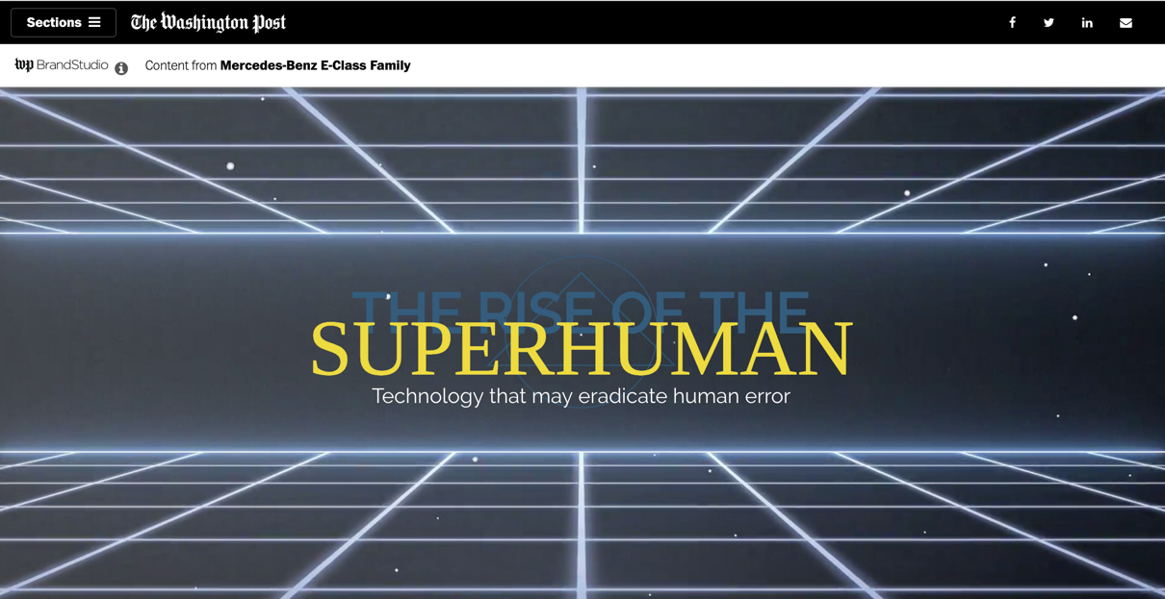
Disclosure Example

Slide 7
Disclosure Example

Slide 8
Native Advertising Effects
Company
Native ads looked at 25% more than traditional banner ads.
Medium
Increased ad revenue
Can negatively impact credibility
Consumer
Inability to identify and comprehend disclosure

Slide 9
TARES Test
Truthfulness
Authenticity
Respect
Equity
Social Responsibility
Developed by Baker and Martinson (2001)

Slide 10
Truthfulness of the message
Has the message deemphasized important information? (Baker & Martinson, 2001) | Does the message represent the whole, complete truth? Was information left out in order to misdirect the persuadee? (Deaver, 1990) | Would I feel the message were complete if given to me in the provided context? (Baker & Martinson, 2001)
Does the message lead people to believe what I myself do not believe? (Bok, 1989) | Is the information withheld critical in allowing the persuadee to make an informed decision? (Fitzpatrick & Gauthier, 2000) | Does the message deceive people either explicitly or implicitly? (Bok, 1989)
conceptual, complete, unobstructed truth

Slide 11
Authenticity of the Persuader
Do I personally believe in this product? (Baker & Martinson, 2001) | Do I personally believe the persuadee will benefit? (Baker & Martinson, 2001) | By putting out this message, am I perpetuating corruption? (Martinson, 1999)
Is this cause or product something I would personally advocate for? (Baker & Martinson, 2001) | In participating in this action is my integrity being called into question? (Baker & Martinson, 2001) | Am I happy to take responsibility for this message? (Waltz, 1999)

Slide 12
Respect for the pursuadee
Does this message allow persuadee to act with free-will and consent? (Cunningham, 2000) | Does this message pander to or exploit its audience? (Baker & Martinson, 2001) | Have I taken the rights, and well-being of others into consideration with the creation of this message? (Baker & Martinson, 2001)
Will the audience benefit if they engage in the action the message portrays? (Baker & Martinson, 2001) | Does the information adequately inform the audience? (Cunningham, 2000) | Is the message unfair or to the detriment of the audience? (Baker & Martinson, 2001)

Slide 13
Equity of the persuasive appeal
Will the audience understand they are being persuaded not informed? (Baker & Martinson, 2001) | Have I unfairly targeted a specific or vulnerable population? (Patterson & Wilkins, 2014) | Would I feel this message was equitable if presented to me or someone I love? (Baker & Martinson, 2001)
Does this message exploit a power differential? (Gauthier, 2000) | Does the message take into account the special needs or interests of the target population? (Cooper & Kelleher, 2000) | How can I make this message more equitable?

Slide 14
Social responsibility for the common good
Does this message help or hinder public trust? (Bok, 1989) | Does this message allow for consideration of opposing views? (Moyers, 1999) | Does this message create the opportunity for public dialogues? (Cunningham, 2000)
Will having or not having this information lead to harm for individuals or groups? (Fitzpatrick & Gauthier, 2000) | Have the messages potential negative impacts been taken into account (Baker & Martinson, 2001) | Does this message unfairly depict groups, individuals, ideas or behaviors? (Baker & Martinson, 2001)

Slide 15
Discussion
How would you balance the components of the TARES test to make an ethical decision?
How can you make disclosure clear and identifiable?
What are the potential positive and negative effects of native advertising?

